Slide 1
Bootcamp Journey
Week-4
M Kaushik, mkaushik.kaushik@team.telstra.com​

Slide 2
Topics covered
Cloud Fundamentals- Azure, AWS
Frontend development- HTML, CSS, JS
Backend development​-Server, REST, Spring

Slide 3
AWS
EC2 (Elastic Compute Cloud): A scalable virtual server service in AWS that allows users to run applications on the cloud with customizable compute capacity.
Simple Storage Service: An object storage service in AWS that enables users to store and retrieve large amounts of data in a highly scalable and secure manner.
Load Balancer and Types: A service that distributes incoming traffic across multiple servers to ensure availability and reliability, with types including Application Load Balancer (layer 7), Network Load Balancer (layer 4), and Classic Load Balancer (layer 4 and 7).
Auto Scaling Groups: A feature in AWS that automatically adjusts the number of EC2 instances based on demand to maintain optimal performance and cost-efficiency.

Slide 4
Backend Development - Server
Server Basics:
A server is a computer or system that provides resources, data, or services to other computers, known as clients, over a network.
Types of Servers:
Web Server
Application Server
Database Server
File Server
Mail Server
Proxy Server
DNS Server
FTP Server
Virtual Server

Slide 5
Backend Development - REST API
REST API Design:
REST (Representational State Transfer) API design focuses on building scalable web services that use standard HTTP methods (GET, POST, PUT, DELETE) to perform CRUD operations.
Exception Handling:
In REST APIs, exceptions are handled by returning appropriate HTTP status codes (e.g., 404 for not found, 500 for server errors) along with a structured JSON response detailing the error message.
Authentication:
REST APIs use token-based authentication methods like OAuth2, JWT (JSON Web Token), or API keys, where a client sends a token in the HTTP headers with each request to verify its identity.
Authorization:
Authorization in REST APIs determines what resources the authenticated user is allowed to access or manipulate, often enforced through role-based access control or permissions associated with the user’s token.

Slide 6
Backend Development - Spring
Why is Spring Used?
Spring is a comprehensive framework for building enterprise-level Java applications, providing features like dependency injection, aspect-oriented programming, and transaction management, which promote modularity, testability, and ease of integration with other technologies.
Why is Spring Boot Used?
Spring Boot is built on top of the Spring framework and is used to simplify the setup and development of Spring applications by providing default configurations, embedded servers, and a variety of pre-built components, allowing developers to create production-ready applications with minimal configuration and code.

Slide 7
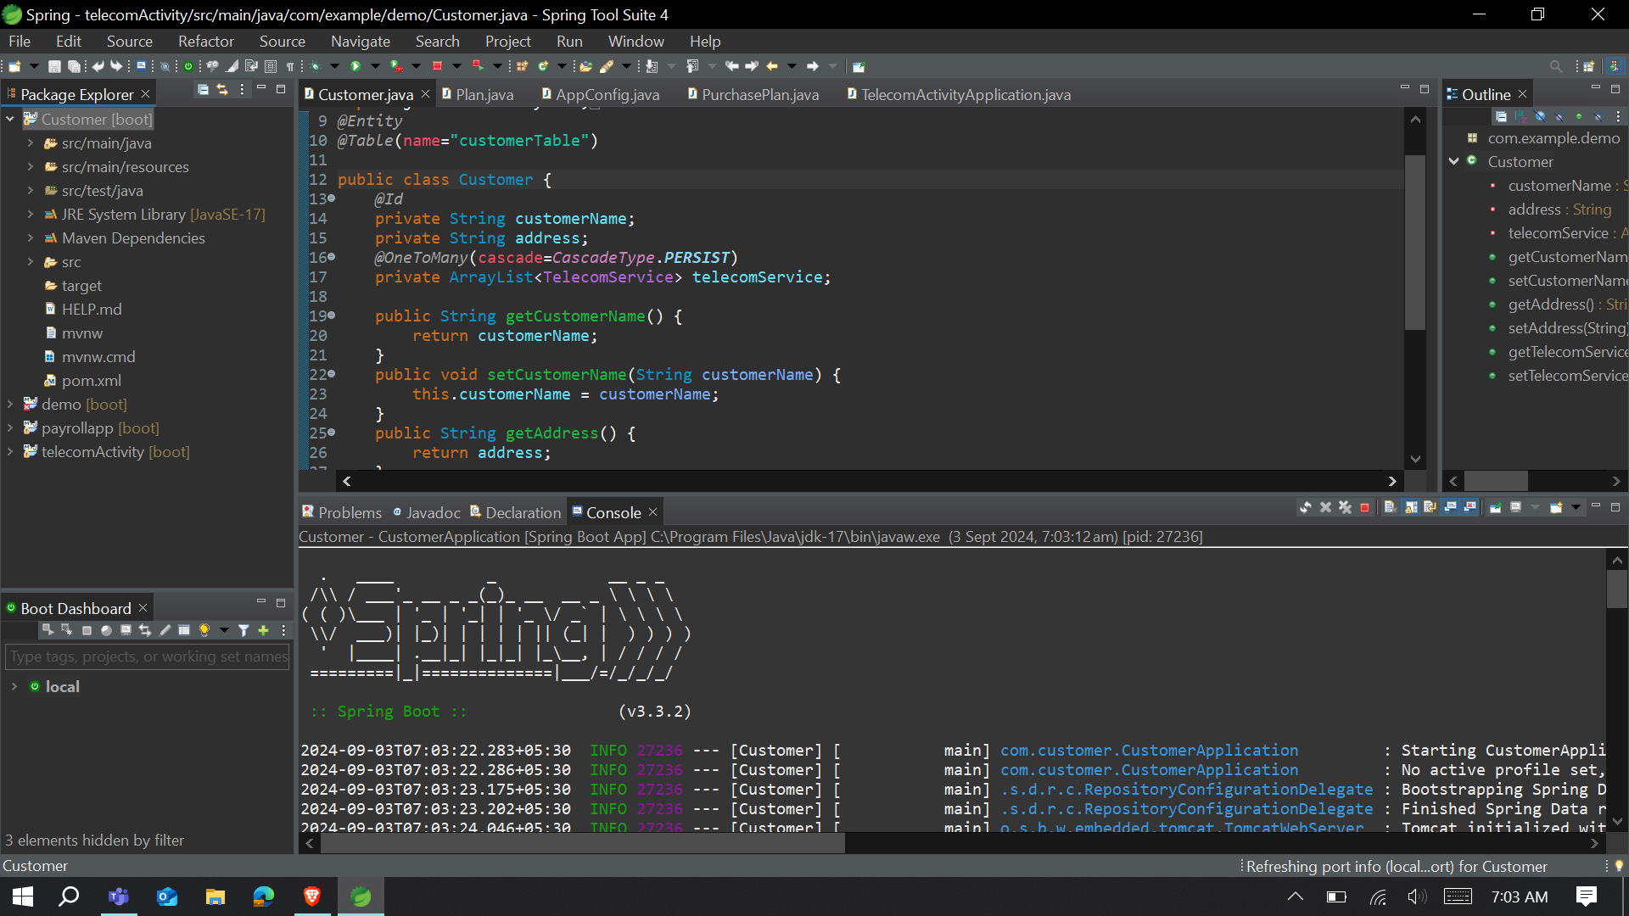
Backend Development - Spring
Figure: Spring App for a use-case of customer

Slide 8
Frontend Development
HTML (HyperText Markup Language): The standard language used to structure and display content on the web.
CSS (Cascading Style Sheets): A stylesheet language used to control the presentation, layout, and design of web pages.
JavaScript (JS): A programming language that adds interactivity and dynamic behavior to web pages. It enables client-side scripting, allowing web pages to respond to user actions without needing to reload, enhancing user experience.

Slide 9
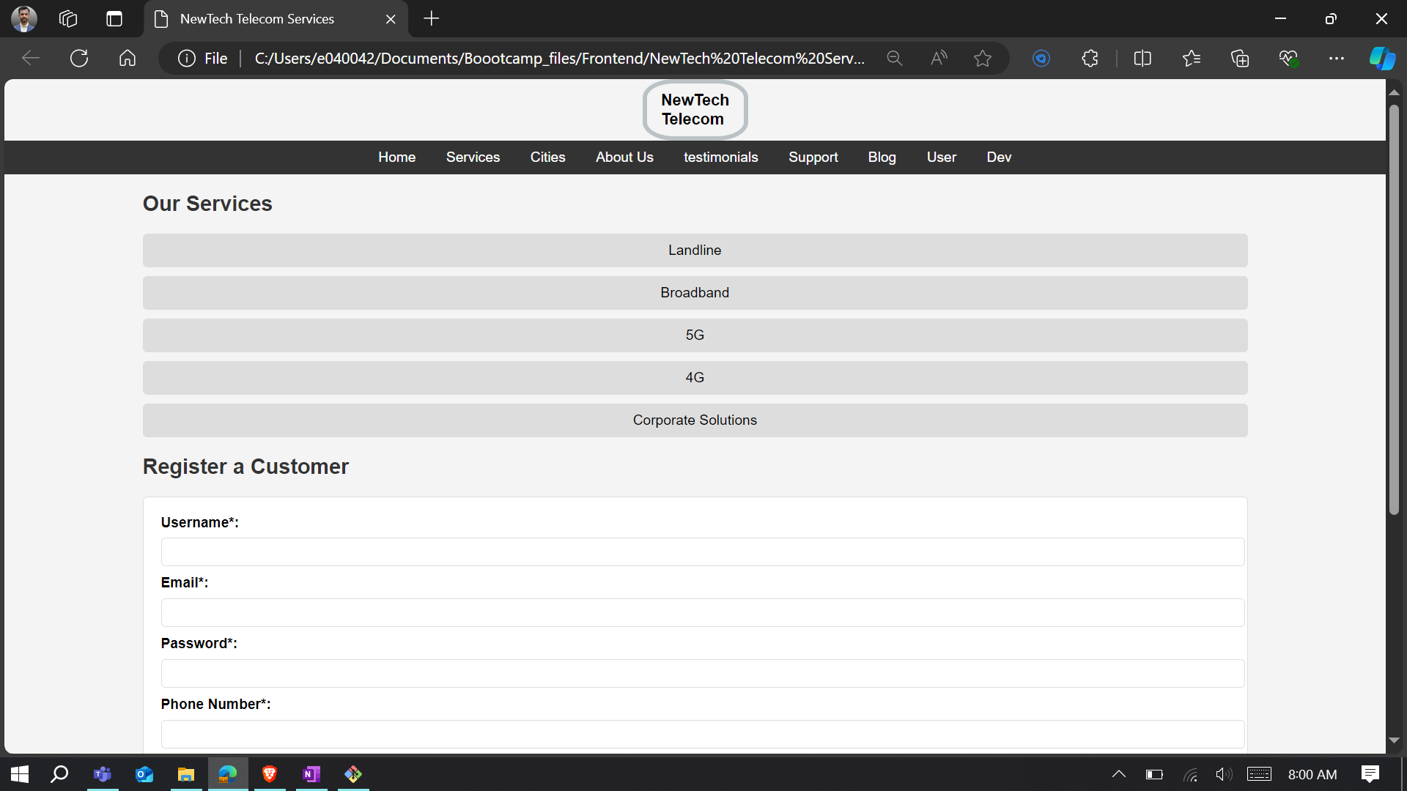
Frontend Development
Activity on Frontend development: https://github.com/Kaushiktelstra/Frontend-Activity

Slide 10
Thank you

